Slide 1
EMPLOYEE DATASET USING EXCEL
STUDENT NAME : SATHISH KUMAR S
ROLL NO : 122CMC41
REG NO : 312214122
Naan
mudhalvan id :539E897E6700545A6604FFBF5C7EB652
DEPARTMENT : B.COM (COMMERCE)
COLLEGE : ST. THOMAS of arts & science

Slide 2
Employee’s data from analysis with using of Excel

Slide 3

AGENTA
Problem Statement
Project Overview
End users
Our solution and Proposition
Dataset description
Modelling Approach
Results and Discussion
Conclusion

Slide 4


PROBLEM STATEMENT
This project stated the employee’s data from different industries analysis with using of Excel

Slide 5


PROJECT OVERVIEW:
This project shows the employee’s data from different industries with using of excel

Slide 6


WHO ARE THE END USER?
Organisation peoples are the end user of this analysis which named as employee’s data from different industries with using excel.
Ex:
Managers
Employers
Employees

Slide 7



OUR SOLUTION AND ITS VALUE PROPOSITION
Filtering – Remove missing values
Sorting – Smallest to Biggest
Conditional Formatting – Remove blank values
Pivot table - Summary of employee’s salary
Groups – Final reports

Slide 8
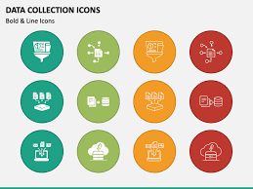
DATASET DESCRIPTION:
Kaggle - Employee Dataset
36 features
Considering features are below;
Profession
Industries
Business
Gender
Way
Grey wages
Annual income income, etc.,

Slide 9


THE “WOW” IN OUR SOLUTION
Employee’s data has been calculated using excel is considered.

Slide 10
MODELING:
Step: 1 ⇨Dataset Collection
Step: 2 ⇨Dataset Preparation
Cleaning
Filtering
Conditional Formating
Insert Pivot table
Insert graphs for final result
Step: 3 ⇨Employee’s data calculated

Slide 11
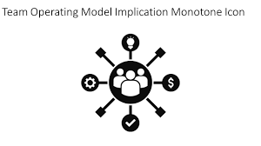
MODELING:
Step: 4 ⇨ Insert Pivot table for given dataset
Step: 5 ⇨ Insert Graph chart for showing final report of Employee’s data
Step: 6 ⇨Summarization of employee’s data based on their way, Grey wage, Education, Gender....Data visualization using Bar Chart.

Slide 12
RESULT: EMPLOYES

Slide 13
EMPLOYEES DATA

Slide 14


CONCLUSION:
This Project explain the employee’s from different data industries like way, greywages, education, gender, data visualisation, etc., with using of excel.
This is benefit for organisation growth and Employee’s work improvement.

